Slide 1
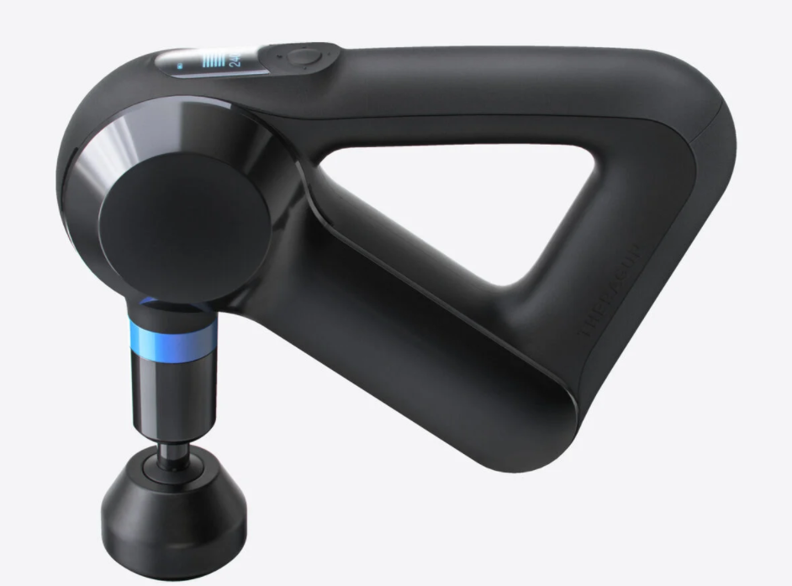
THERAGUN
Percussion Massager

Slide 2
How does the Theragun work?
Theragun pioneered a revolutionary field of recovery known as percussive therapy This works by delivering a unique combination of targeted deep-tissue massage, at a high-speed frequency, with the ability to apply sufficient force to the area.
Every Theragun reaches 16 mm (60% deeper than other massage guns) into your muscle, increasing circulation. This supports your body’s ability to repair and helps you feel better.
Each device touches and retracts away from the body 40 times per second (per second!), a precise calibration that distracts the brain away from pain while also delivering deep, effective treatment.
The powerful and deceptively quiet motor allows you to apply ample downward pressure to your muscles without causing damage, and without stalling out like other massage guns.
Percussive therapy has many benefits beyond just immediate tension relief, including hydrating your muscle tissue, improving mobility, decreasing lactic acid, increasing blood flow, and decreasing muscle soreness and stiffness.

Slide 3
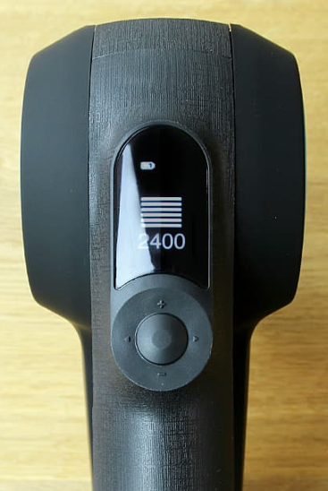
Proper Use…
Turn on the Theragun before putting it on your body. This way, you can adjust to your preferred power before getting started.
Rest the Theragun on your body. The key here is to just let it float on the surface of your muscle without any additional pressure.
Run the Theragun along your desired area, slowly. If you discover a knot or high-tension area, spend some extra time on that spot. You can also apply additional downward pressure to help release tension in troublesome spots.
Use plus and minus (+/-) buttons to adjust the speed up and down
Relax and let Theragun melt away your stress.

Slide 4
How often should I use my Theragun?
This depends on the area you’re treating and the length of each session. We recommend a minimum of 15 seconds and a maximum of 2 minutes per muscle group. A full-body session should not exceed 15 minutes.
Pre-activity warm-up
Prior to workouts or physical activity, float your Theragun for up to 30 seconds to instantly activate and “wake up" your muscles.
During activity
Reactivate muscles during your workout or any activity by using your Theragun for 10-15 seconds on the muscle group. This will re-energize, relieve muscle spasms and fatigue, and keep muscles active.
Post-activity and recovery
Float your Theragun for up to 2 minutes for muscle recovery post-workout to decrease soreness on any muscles that require immediate pain relief.

Slide 5
Theragun Attachments

Slide 6
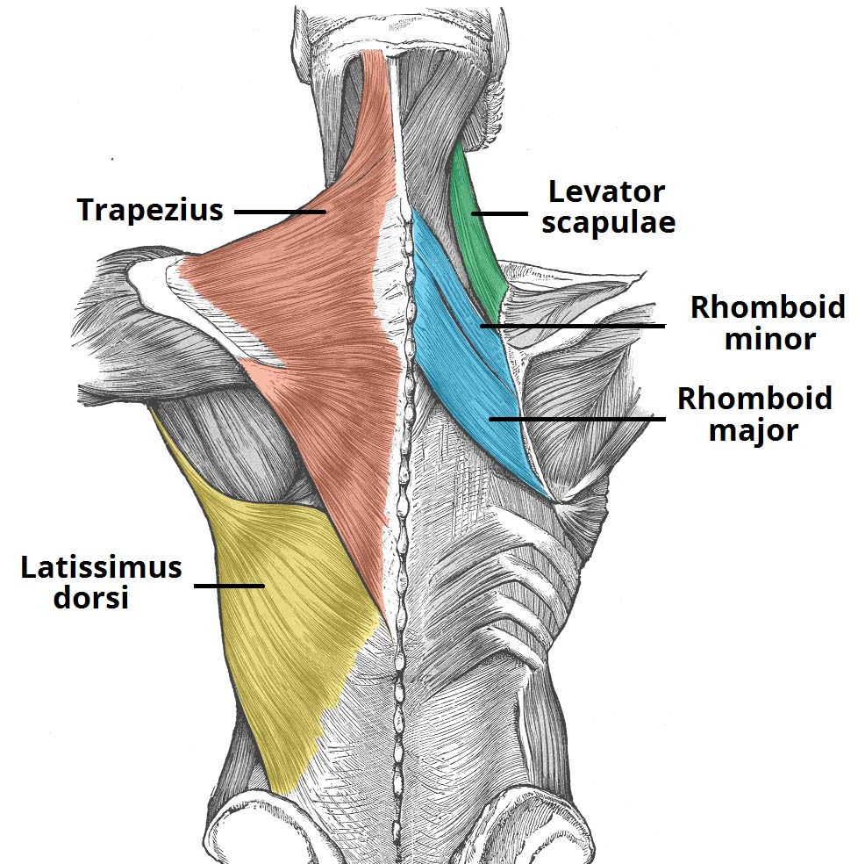
Shoulders and Back

Slide 7
Erector Spinae Muscles

Slide 8
Hip & Gluts

Slide 9
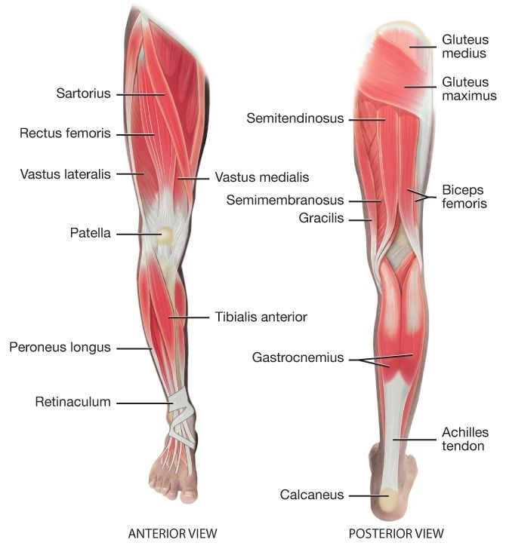
Lower Limb Muscles

Slide 10
Upper Limb Muscles

Slide 11
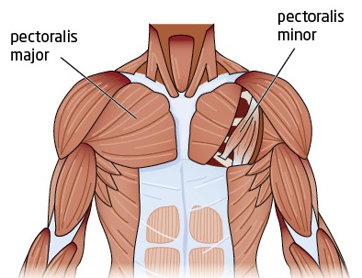
Chest Muscles

Slide 12
QUESTIONS…
Ask Dr. Nick
Email
Teams

