Slide 1
Stick Mobility
Stretching Basics

Slide 2
About Stick Mobility…
Stick Mobility is a training system that improves your flexibility, strength, and coordination.
The system combines joint mobilization, strength training, and active stretching to increase athletic performance, reduce risk of injury, and accelerate recovery.
The exercises use our custom-designed Training Sticks as tools to improve range of motion, muscle activation, coordination, and body awareness to build a strong foundation for better movement.
Our system is based on the scientific principles of leverage, stability, feedback, irradiation, isometrics, and coordination.

Slide 3
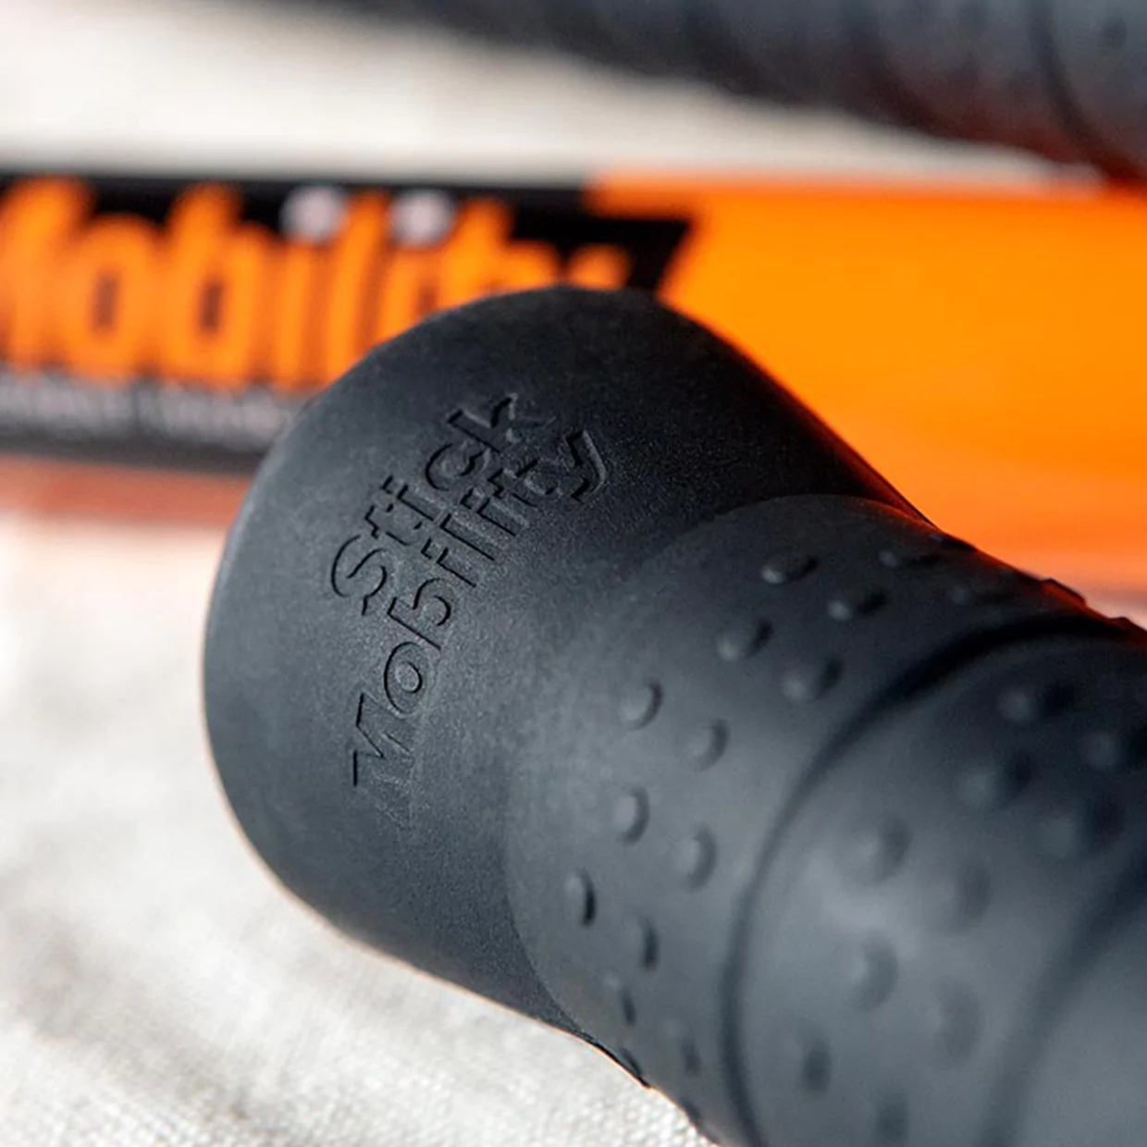
Benefits…
With frequent practice, we have seen users improve their:
Functional range of motion Joint stability Balance Posture Full-body strength Coordination Tissue quality Athletic performance Body alignment Muscle activation Motor control Body awareness Protection from injury Recovery from injury Recovery from exercise faster

Slide 4
Easy Stretches…

Slide 5
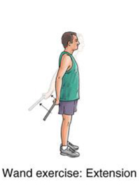
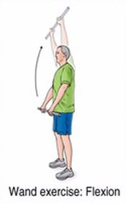

Slide 6
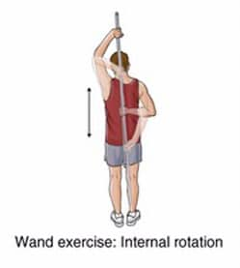
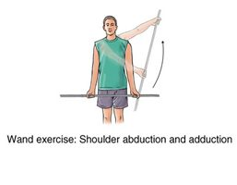

Slide 7
Safety Precautions
Give yourself plenty of room to avoid any obstructions
Avoid overstretching
Maintain balance during body movements to avoid falls
If you are experiencing any discomfort (more than just a stretching sensation) discontinue use of equipment

Slide 8
QUESTIONS…
Ask Dr. Nick via Email or Teams.

