Slide 1
Vertiball
Wall Mounted Massage Roller

Slide 2
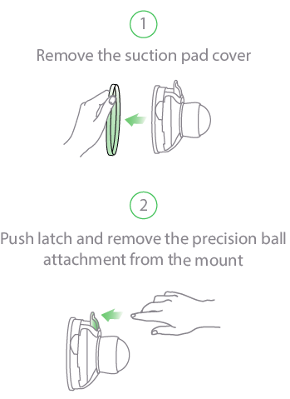
Getting Started

Slide 3
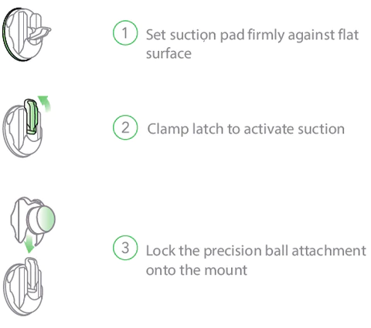
Mounting

Slide 4
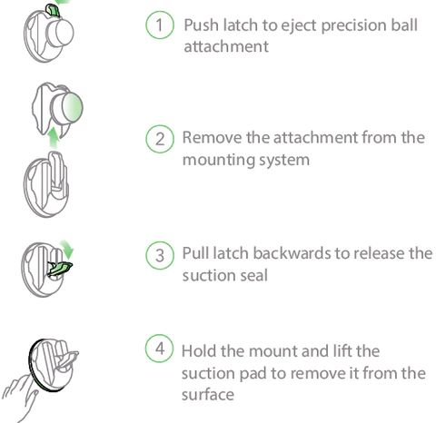
Dismounting

Slide 5
Release myofascial pain to eliminate muscle knots and to reduce inflammation and strain on soft tissue trigger points.
Simply lean on Vertiball with your body weight to relieve muscle knots and tension. You control how much pressure to apply.

Slide 6
Trigger Point Therapy
Trigger points or muscle knots, are involuntary tight, tender spots in a contracted muscle and can be described as "myofascial pain syndrome".
Self-myofascial release has been found to increase your range of motion, flexibility, and overall athletic performance while decreasing muscle pain.

Slide 7
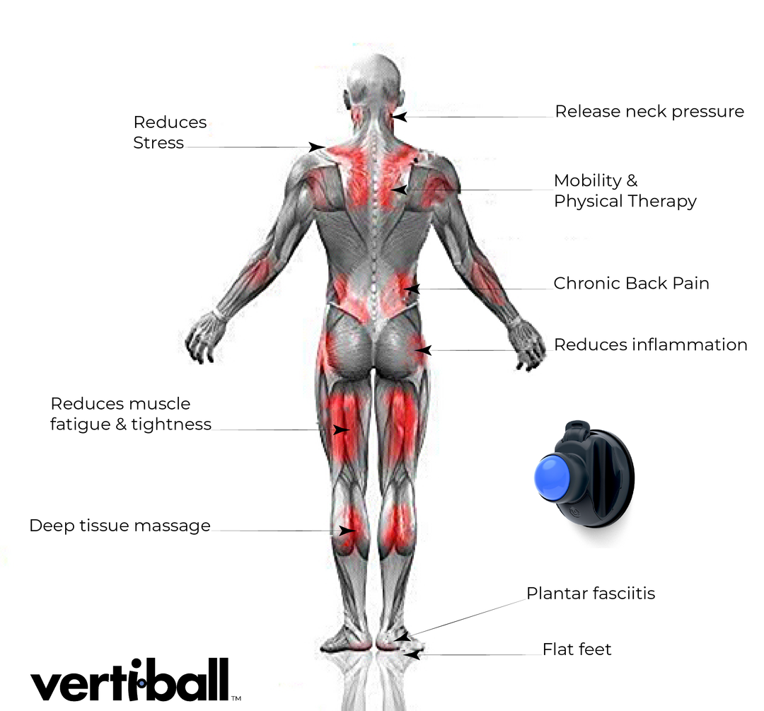

Slide 8
User Safety
While the Vertiball company does not specifically list any safety precautions for using their product, it is important to be aware of when to avoid use.
These include:
Skin rash, open wounds, blisters, local tissue inflammation, bruises, or tumors
Bone fracture
Neurologic conditions resulting in loss or altered sensation
Recent surgery or injury
Extreme discomfort or pain in treatment region

Slide 9
QUESTIONS…
Ask Dr. Nick
Email
Teams

