Slide 1
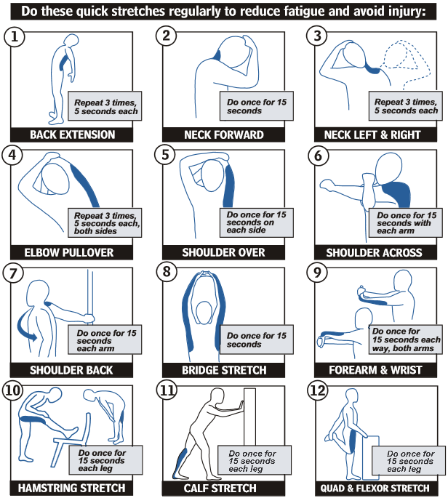
OFFICE STRETCHING

